Slide 1
Papi’s Pictures Photo Gallery
CIS 386 Database Project
Brendan Short
12/1/25

Slide 2
Organization Overview
“Client”: my dad, a hobby landscape and drone photographer
Shoots Northern Michigan landscapes (shoreline, woods, small towns)
Stores everything on a single external hard drive
Loose folders and file management; no real catalog or search

Slide 3
Purpose & Desired Outcomes
Make his work findable: search by tag, location, drone, etc.
Provide a central place to browse both photos and videos
Reduce the risk of losing everything if the hard drive fails
Meet course requirements while building something he can actually use

Slide 4
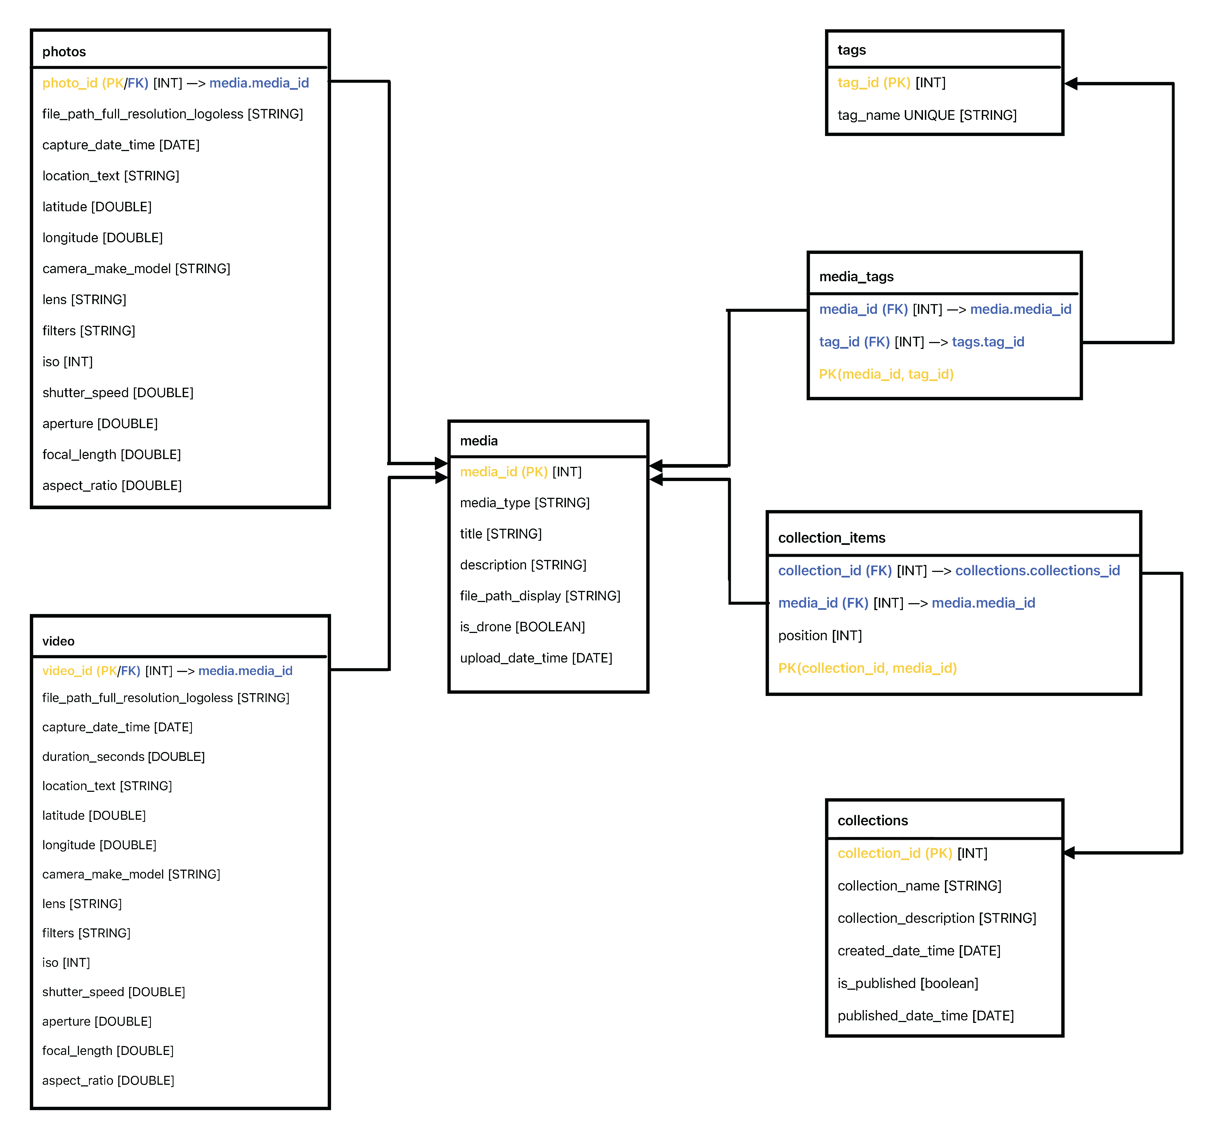
Architecture – Schema
media table: one record per photo or video
Stores title, description, and file path to the display-sized version
photos and videos tables act as subtypes and share the same PK as a FK back to media
tags and media_tags implement zero-to-many tagging
collections and collection_items implement zero-to-many associations for curated sets of media, with ordering

Slide 5
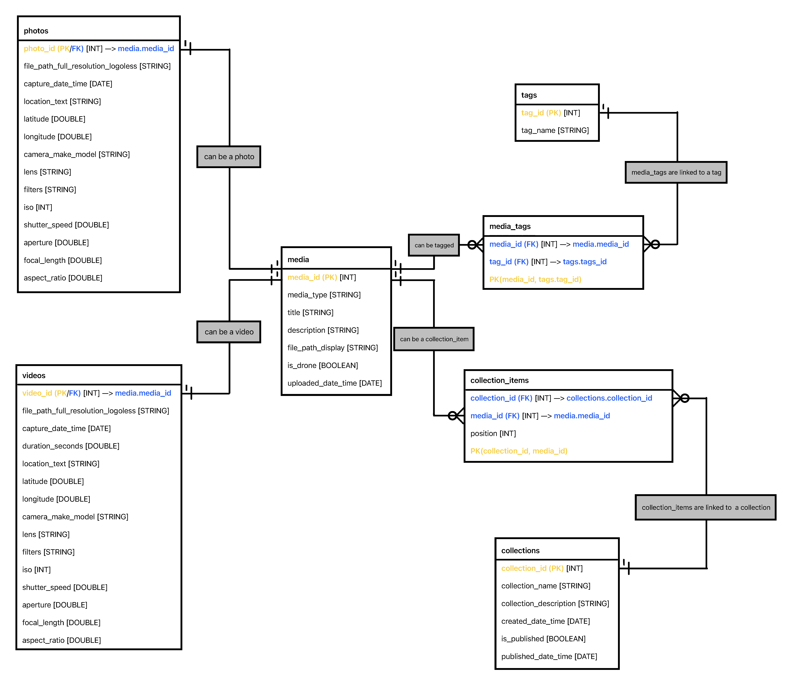
Architecture – ER Diagram
media sits at the center as the main table
This table is referenced by the application gallery to display images and videos
1-to-1 from media (supertype) to photos and videos
Every row in photos corresponds to exactly one row in media
Every row in videos corresponds to exactly one row in media
0-to-many between media and tags (via media_tags)
A media item can have zero or many tags; a tag can be applied to zero or many media items
0-to-many between media and collections (via collection_items)
A media item can be in zero or many collections; a collection can contain zero or many media items

Slide 6
Implementation Process – Ingestion
Export from Lightroom / Creative Cloud:
Full-resolution master photo without watermark
Resized display versions for use in the application layer
Use ExifTool to pull metadata from media files
Scripts to transform EXIF metadata into CSV. Then using CSV to create SQL INSERT statements
Load data into MySQL using prepared table-creation and table population .sql scripts
This ingestion process seemed straightforward but was actually the most time-consuming part

Slide 7
Roadblocks & Fixes
Missing and inconsistent EXIF fields
Windows cannot see Lightroom metadata natively, so ExifTool was needed to export metadata to CSV
Some fields were missing because metadata is not always fully preserved on import into Lightroom / Creative Cloud
CSV cleanup and SQL syntax errors
ExifTool was completely new, so learning the right commands took time
CSVs exported with every possible Lightroom field, even when values were null
Required extensive CSV cleanup before creating SQL import scripts
File path mismatches
File paths stored in the database did not always match actual file locations
Result: media would not display correctly in the application layer
AMPPS / PHP configuration and query issues
Some PHP queries were misconfigured
Media would either not display or would reference the full-size media instead of the resized and watermarked versions

Slide 8
Application Layer (PHP + MySQL) – Gallery
PHP application running on AMPPS, connected to MySQL
Gallery grid view shows thumbnails of media, including:
Drone vs regular camera indicator
Capture date
Title
Tags
Gallery filters:
Search box
Tag selection dropdown
Capture type selection (e.g., drone vs non-drone)
Season selection
Location search box
Aspect ratio selection (important for printing photos as the proper size)
Camera selection
Captured after date input
Captured before date input

Slide 9
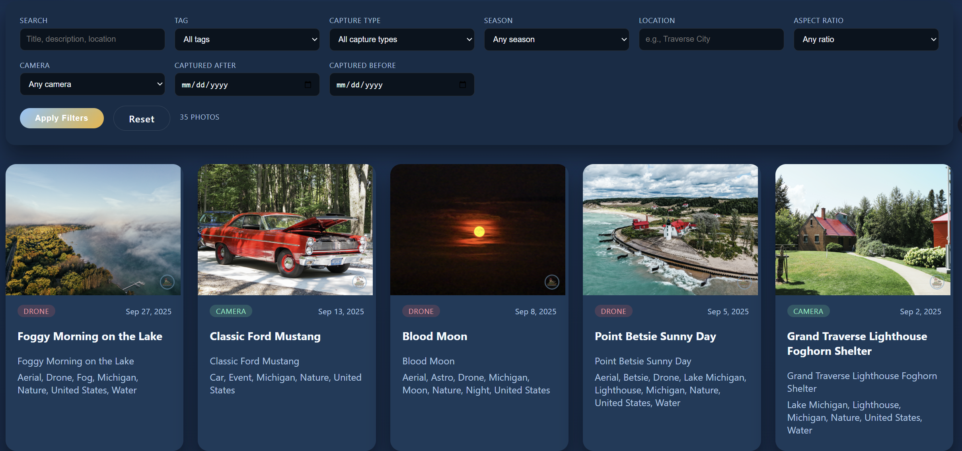

Slide 10
Application Layer – Detailed Media View
Detailed view for individual media items
Shows detailed metadata for the selected media, including:
Exact capture date and time
Camera model
ISO
Shutter speed
Aperture
Focal length
Tags

Slide 11
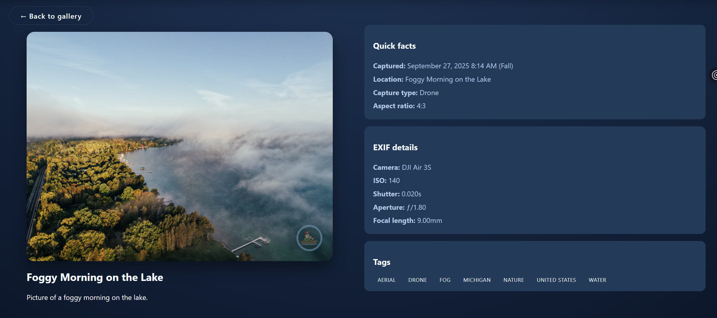

Slide 12
Application Layer – Collections & Videos
Collections:
Collected sets of media with an explicit order
Links to view each media item in the same detailed view as the gallery
Videos:
Separate area to view video media, distinct from photos and collections
Can view videos as thumbnails or full-screen
Clicking a video opens a detailed view with the same metadata layout as the photo gallery

Slide 13
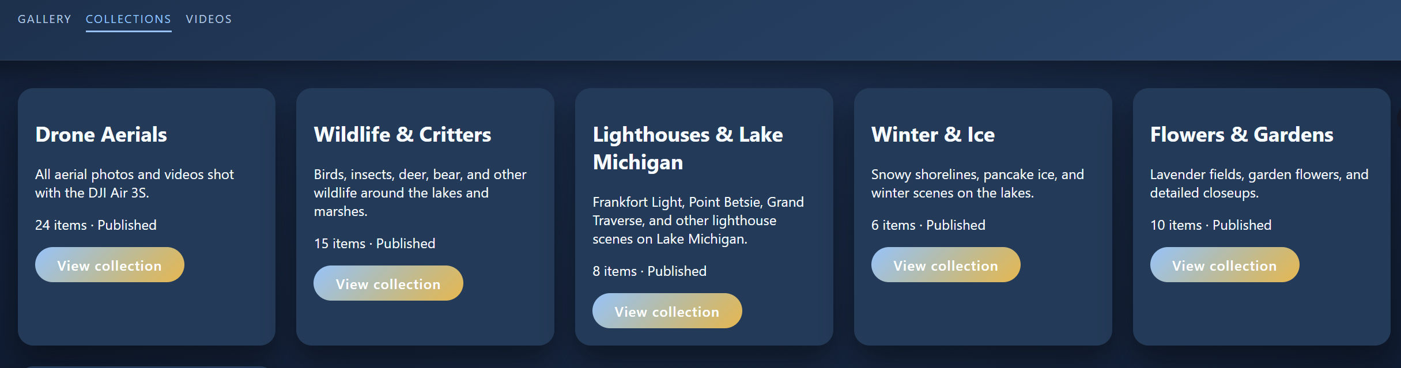
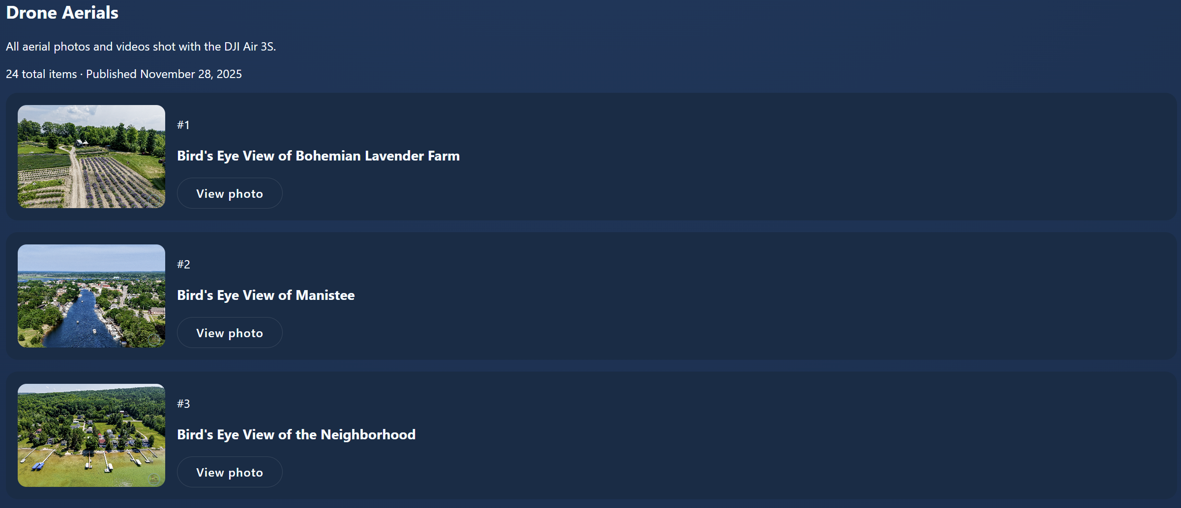

Slide 14
Application Layer – Current Bugs
Gallery:
The title of the media prints twice
It should show “title then description,” but it shows “title then title” (data mapping issue) **FIXED**
Detailed photo view:
The title is printing in the Location field (data mapping issue) **FIXED**
Collections:
After viewing a media item in a collection’s detailed view, using the back button returns to the main gallery instead of back to the collection view

Slide 15
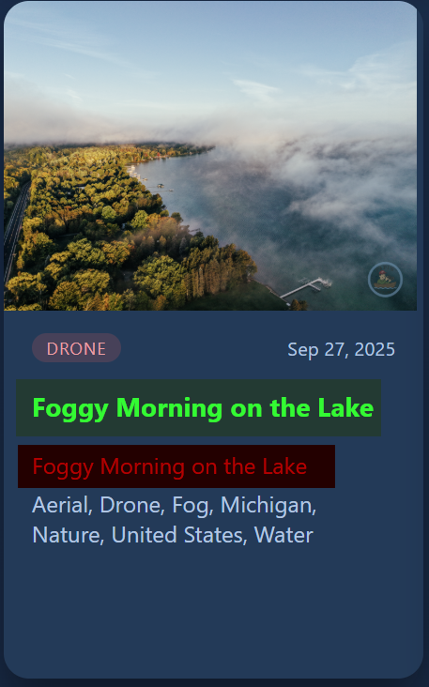
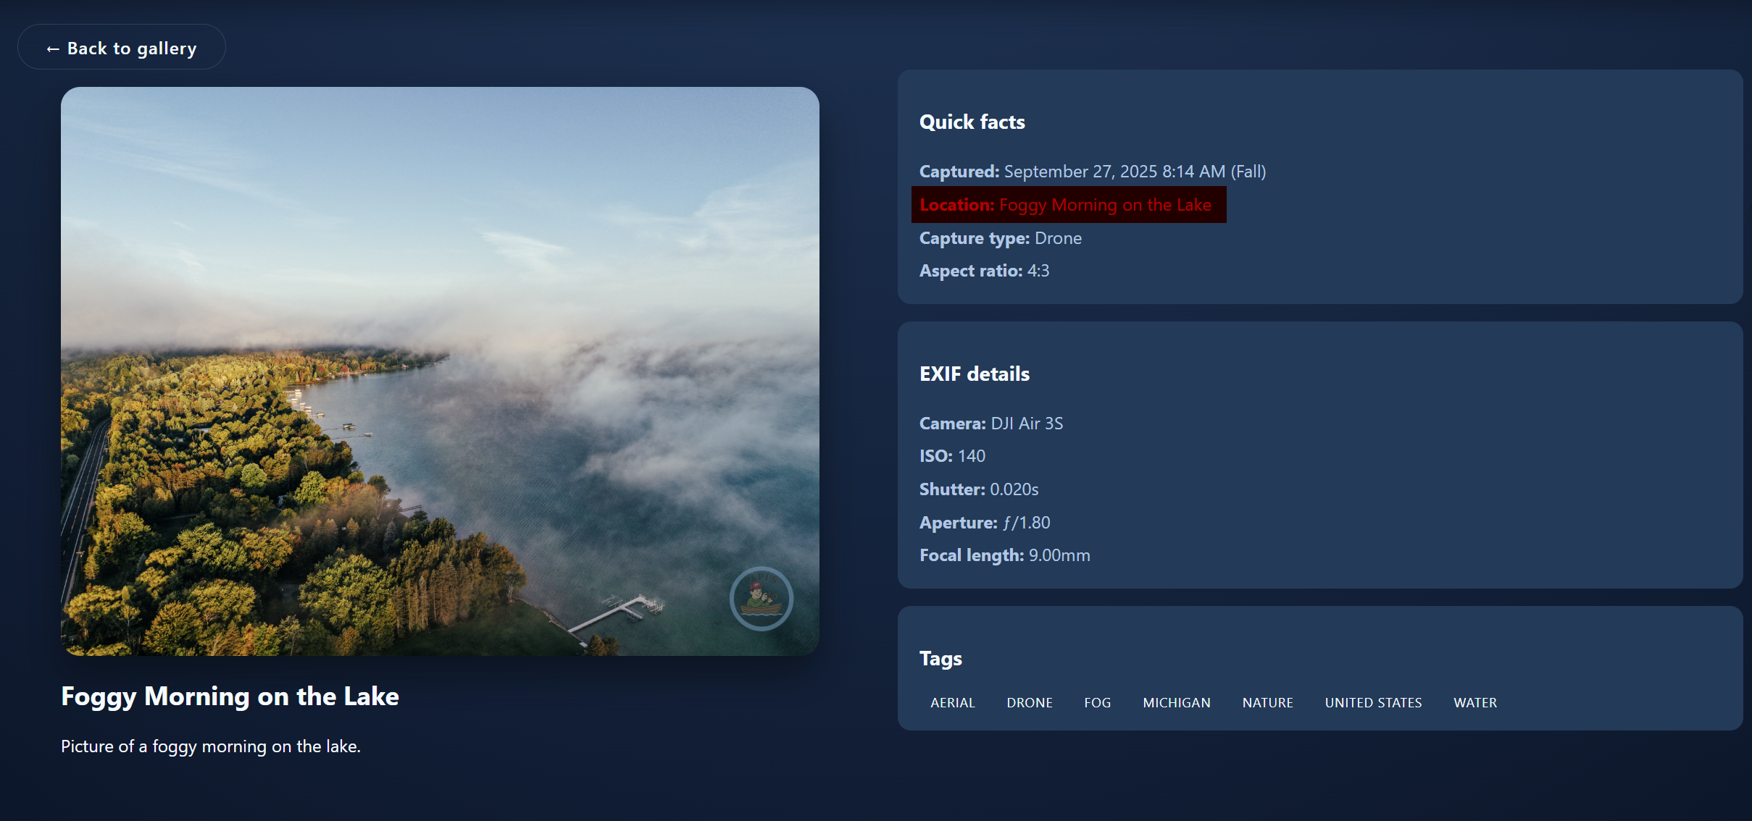

Slide 16
Project Results
Normalized relational schema with primary keys, foreign keys, and constraints
Tables populated with real photo and video data
“Working” PHP front end connected to MySQL (with some fixes still pending)
MySQL and NoSQL (MongoDB) versions of the data model created
No application layer has been built yet for MongoDB

Slide 17
Data Analysis Questions
10+ SQL queries built on top of the schema
Example questions answered:
Media counts by type and by drone vs non-drone
Top tags by usage
Collection statistics (photos vs videos vs drone within collections)
Seasonal or monthly photo counts
Drone usage percentage for each tag

Slide 18
Problems With MySQL
Why MongoDB might be better.

Slide 19
MongoDB Considerations
One document per media item
Each document embeds:
File paths
EXIF / capture metadata
Tags (as an array)
Collection membership and order information
Data analysis implemented as MongoDB aggregation pipelines mirroring the SQL analysis

Slide 20
Future Work
Cleaner, non-developer UI so my dad can use it easily
Automated ingest pipeline:
Current manual work to ingest media makes this system not viable at scale in its present form
Watch a Lightroom export folder
Automatically extract EXIF and update MySQL / MongoDB
Metadata management.
Better handling of storage and backup for media files
Potential public-facing Papi’s Pictures site in the future

Slide 21

GitHub Repository
Scan QR to GitHub repository in browser.
HTTPS clone:
https://github.com/bcshort1/Database-Project.git
GitHub Desktop Command-Line Interface clone:
gh repo clone bcshort1/Database-Project

